Slide 1
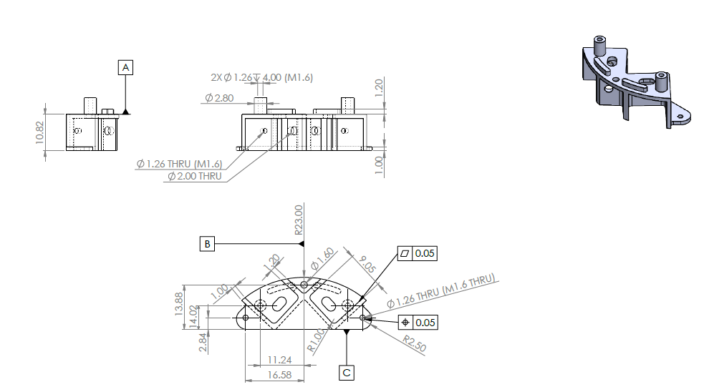
ShiaanX CNC Job Card – Job ID: SX-2025-0041 | Part: 3MNHH_2 (AL-6061 T6)
Job Overview
Job ID | Part Name | Material | Batch Size | Drawing No.
SX_2526_0041 | 3MNHH_2 | AL 6061-T6 | 10 | 3MCYH2

Slide 2
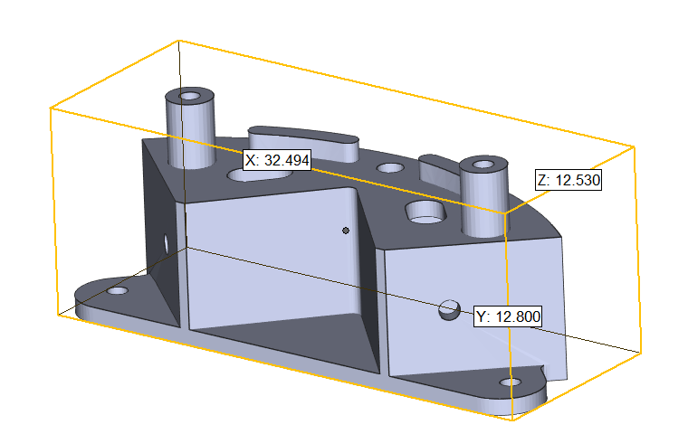
ShiaanX CNC Job Card – Job ID: SX-2025-0041 | Part: 3MNHH_2 (AL-6061 T6)
Raw Material Procurement
Material Specification: AL 6061 T6
Raw Material Shape: Block
Raw Material Size for 1 part: 38*16*18mm
Timeline: Start: 12-09-2025 End: 13-09-2025
Estimated: 2 days
Quality Checkpoint
Checkpoint | Parameter | Tolerance | Frequency | Inspector
QC1 | Raw Material MTC | As per specs | 1 time per batch

Slide 3
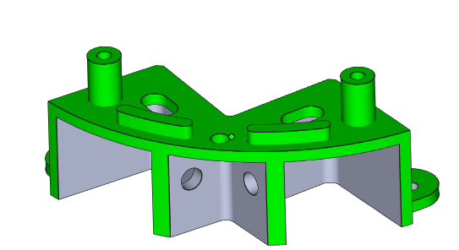
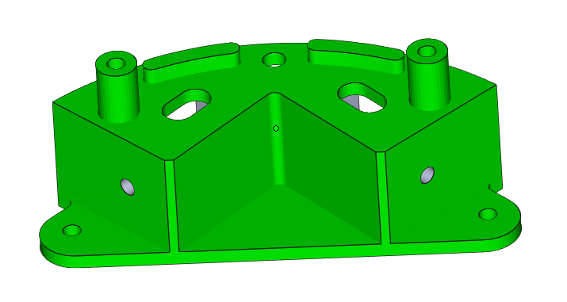
ShiaanX CNC Job Card – Job ID: SX-2025-0041 | Part: 3MNHH_2 (AL-6061 T6)
VMC Setup-1 (Milling and Drilling)
Machine: VMC 3 Axis
Tools: - dia 2 endmill cutter
Tolerance: ±0.05mm
Cutting Parameters: RPM: 1200, Feed: 0.15 mm/rev, DOC: 1.5 mm Timeline: Start: 15-09-2025 End: 15-09-2025
Est:
Green Area- Machined as per 2d drawing
Quality Checkpoint
Checkpoint | Parameter | Tolerance | Frequency | Inspector
QC1 | 1.2 | +0.05mm | 100%
QC2 | Dia 2.8 | ± 0.05 mm | 100%
QC3 | Dia 1.6 | ± 0.05 mm | 100%
QC3

Slide 4
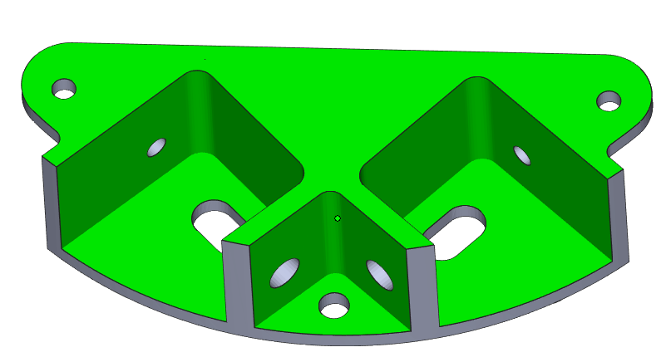
ShiaanX CNC Job Card – Job ID: SX-2025-0041 | Part: 3MNHH_2 (AL-6061 T6)
VMC Setup-2 (Milling)
Machine: VMC 3 Axis
Tools: - dia 2 endmill cutter
Tolerance: ±0.05mm
Cutting Parameters: RPM: 1200, Feed: 0.15 mm/rev, DOC: 1.5 mm Timeline: Start: 16-09-2025 End: 16-09-2025
Est:
Green Area- Machined as per 2d drawing
Quality Checkpoint
Checkpoint | Parameter | Tolerance | Frequency | Inspector
QC1 | 1.2 mm | +0.05mm | 100%
QC2 | 9.05 mm | ± 0.05 mm | 100%
QC3 | 10.82 mm | ± 0.05 mm | 100%
QC3 | 1.00 mm | ± 0.05 mm | 100%

Slide 5
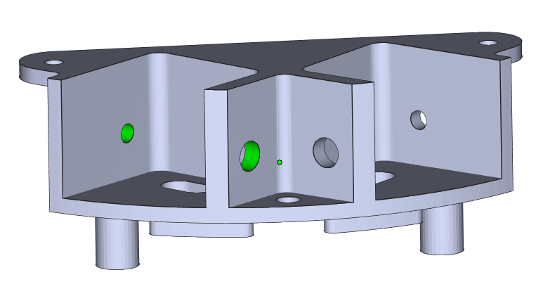
ShiaanX CNC Job Card – Job ID: SX-2025-0041 | Part: 3MNHH_2 (AL-6061 T6)
VMC Setup-3 (Drilling)
Machine: VMC 3 Axis
Tools: - Pilot drill of 1.25mm and 2 mm
Tolerance: ±0.05mm
Cutting Parameters: RPM: 1200, Feed: 0.15 mm/rev, DOC: 1.5 mm Timeline: Start: 17-09-2025 End: 17-09-2025
Est:
Green Area- Machined as per 2d drawing
Quality Checkpoint
Checkpoint | Parameter | Tolerance | Frequency | Inspector
QC1 | Dia 2 mm | +0.05mm | 100%
QC2 | Dia 1.25 mm for Tap | ± 0.05 mm | 100%
QC3
QC3

Slide 6
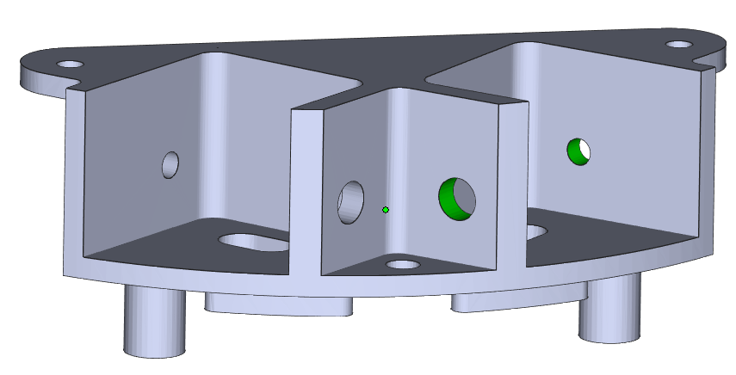
ShiaanX CNC Job Card – Job ID: SX-2025-0041 | Part: 3MNHH_2 (AL-6061 T6)
VMC Setup-4 (Drilling)
Machine: VMC 3 Axis
Tools: - Pilot drill of 1.25mm and 2 mm
Tolerance: ±0.05mm
Cutting Parameters: RPM: 1200, Feed: 0.15 mm/rev, DOC: 1.5 mm Timeline: Start: 17-09-2025 End: 17-09-2025
Est:
Green Area- Machined as per 2d drawing
Quality Checkpoint
Checkpoint | Parameter | Tolerance | Frequency | Inspector
QC1 | Dia 2 mm | +0.05mm | 100%
QC2 | Dia 1.25 mm for Tap | ± 0.05 mm | 100%
QC3
QC3

Slide 7
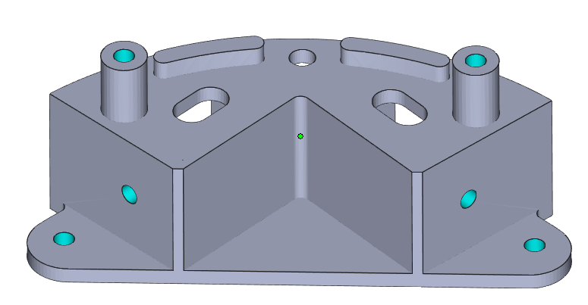
ShiaanX CNC Job Card – Job ID: SX-2025-0041 | Part: 3MNHH_2 (AL-6061 T6)
Setup-5 (Manual Tapping M1.6x0.4mm)
Machine: Manual Tapping
Tools: - Tapping set of M1.6
Tolerance: NA
Tapping Parameters: M1.6x 0.4mm
Timeline: Start: 18-09-2025 End: 18-09-2025
Est:
Blue Area- Tapping as per 2d drawing
Quality Checkpoint
Checkpoint | Parameter | Tolerance | Frequency | Inspector
QC1 | M1.6 x0.4MM | NA | 100%

Slide 8
ShiaanX CNC Job Card – Job ID: SX-2025-0041 | Part: 3MNHH_2 (AL-6061 T6)
Timeline & Sign-off
Start Date | Estimated Completion | Delivery Due Date
15-09-2025 | 18-09-2025 | 22-09-2025
Vendor Signature | Date | ShiaanX Approval | Date

